Slide 1

Analysis of phenomenon
By
Devi Siva Supriya

Slide 2
Description
The data taken for analysis are for month of January in 3 consecutive years 2018, 2019 & 2020
Various phenomenon are observed and analyzed from 2,926,877 trips found in the data logs from website.
https://www.citibikenyc.com/system-data

Slide 3
Phenomenon observed:
Impact of Bike count
Popularity among age groups
Miles covered per ride

Slide 4
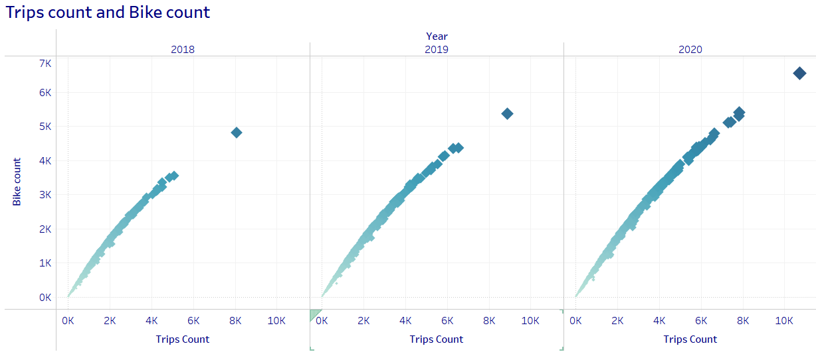
Impact of bike count
As more bikes has been added, it has increased the trip count recorded against the station
The station, Pershing square north is the potential outlier with more bikes and more trips

Slide 5
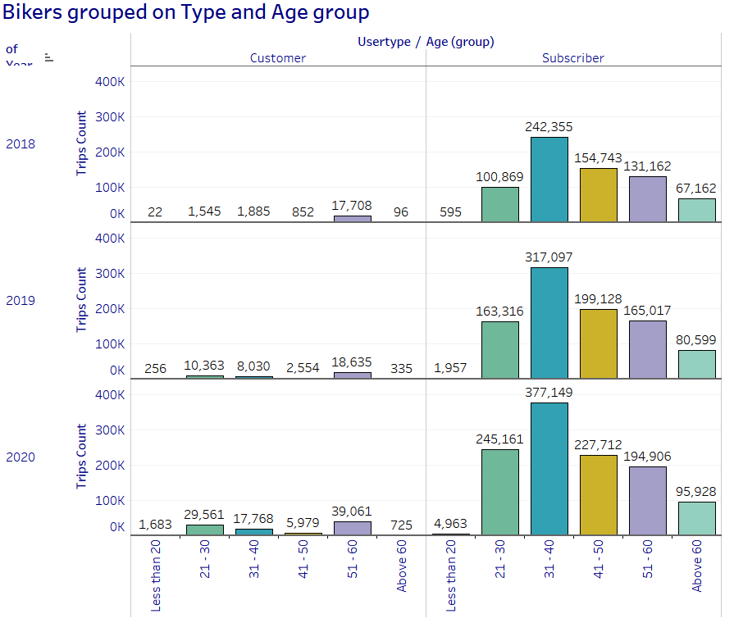
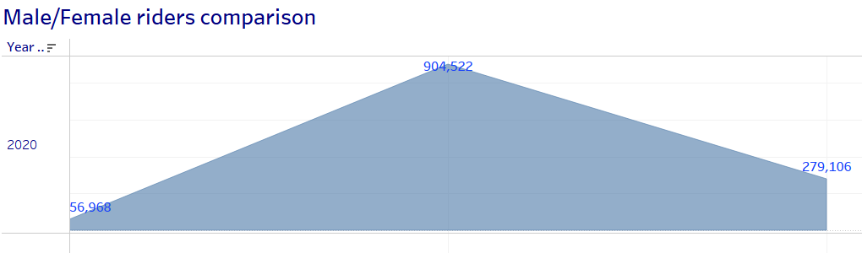
Popularity among age groups/gender
This system is popular among the age groups 30-40
Also we could see, people with memberships uses it more
Male to Female riders are at ratio of 3.5 : 1

Slide 6
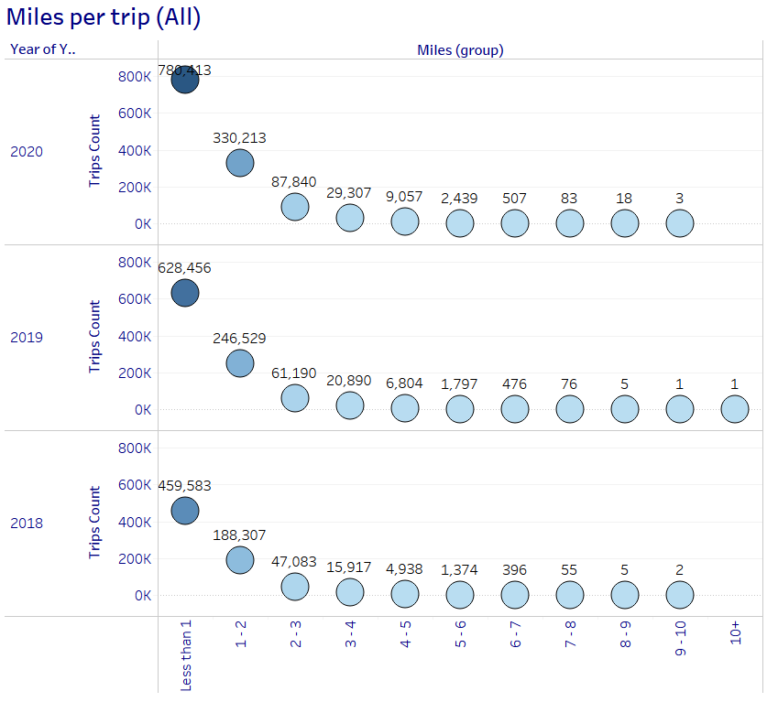
Miles per ride
Bikes are mostly used for rides less than a mile
That being said peak hours are reported during the peak commute times in the city

Slide 7
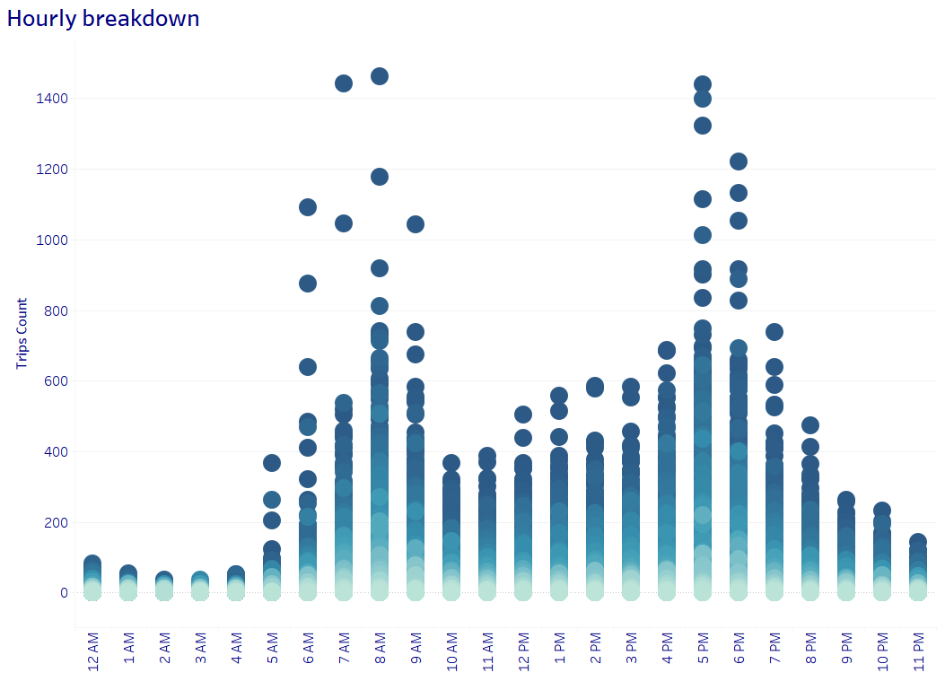
Peak hours
The peak hours of usage are between,
  7am – 9am
  5pm – 7pm
The station Perishing square north has reported more trips during this hours.

Slide 8
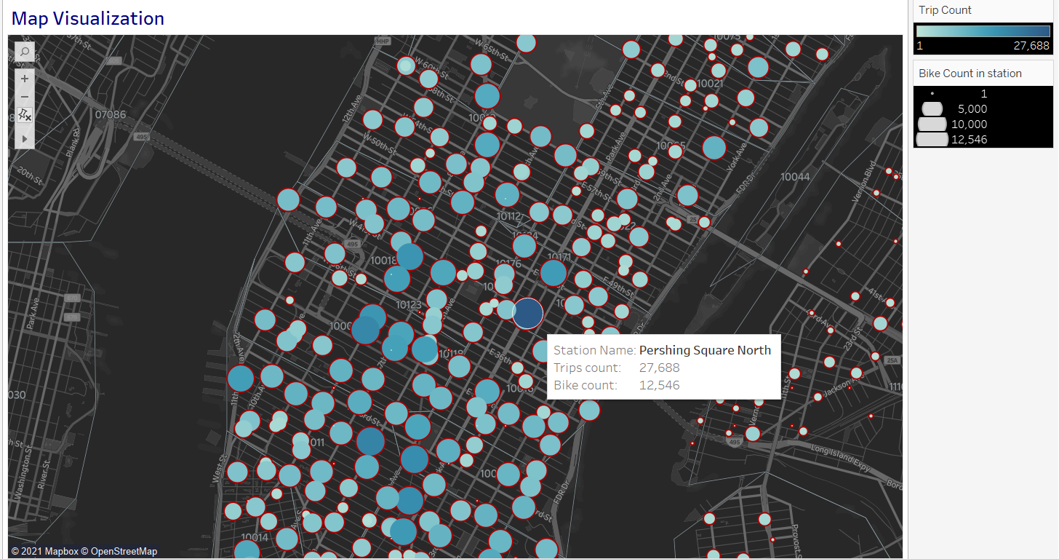
Map Visualization
The map marks the bike stations
The color indicates the popularity of the station
The size indicates the number of bikes the station has

Slide 9
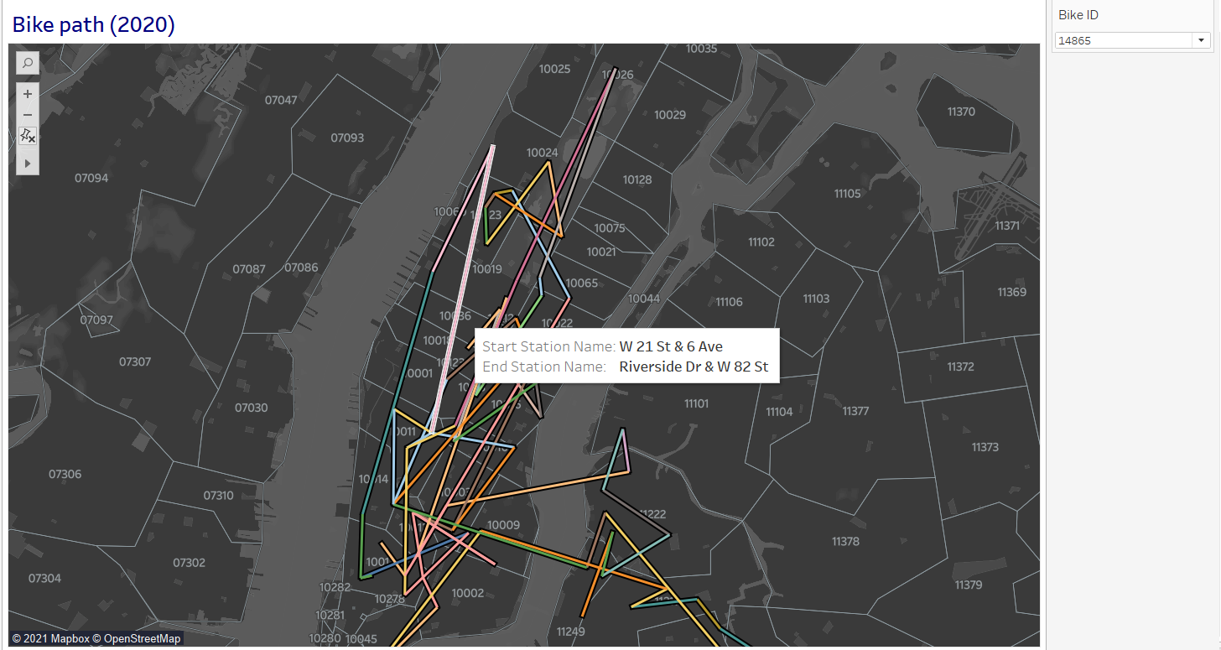
Bike Path (2020)
Another interesting map that shows the path each bike has taken during Jan, 2020
Each bike can chosen from the drop down

Slide 10
Other charts

Slide 11
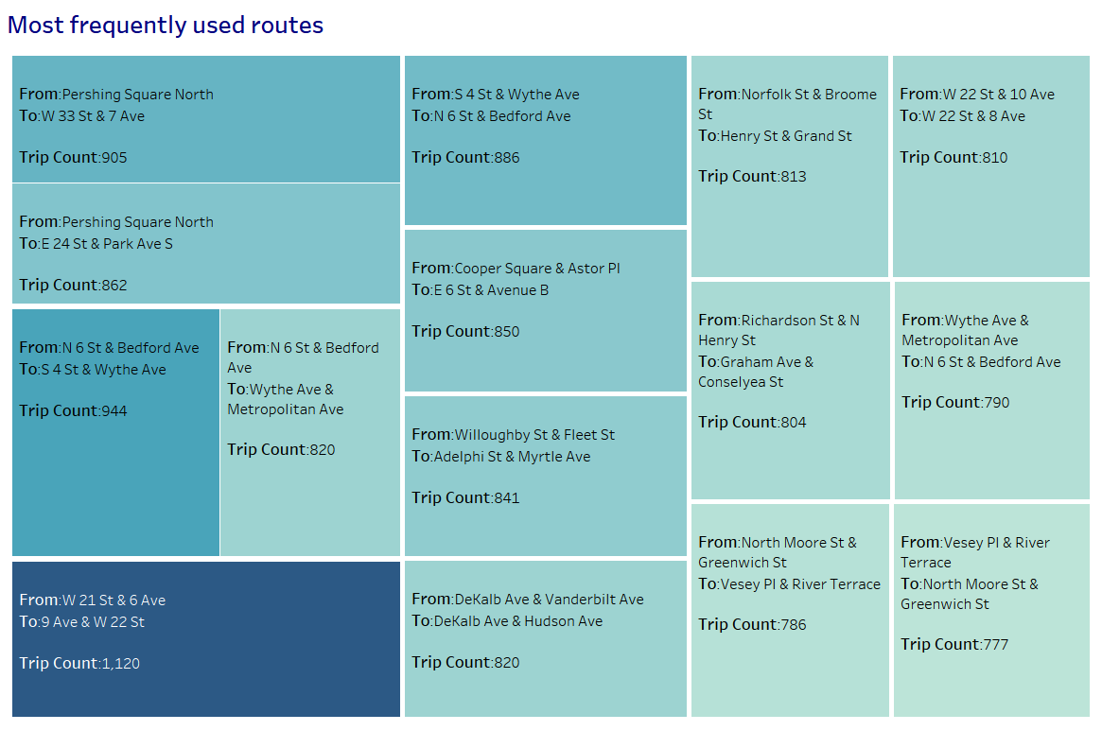
Most frequently used routes
The ride between stations : Perishing square north and W 33 st & 7 Ave has recorded more trips

Slide 12
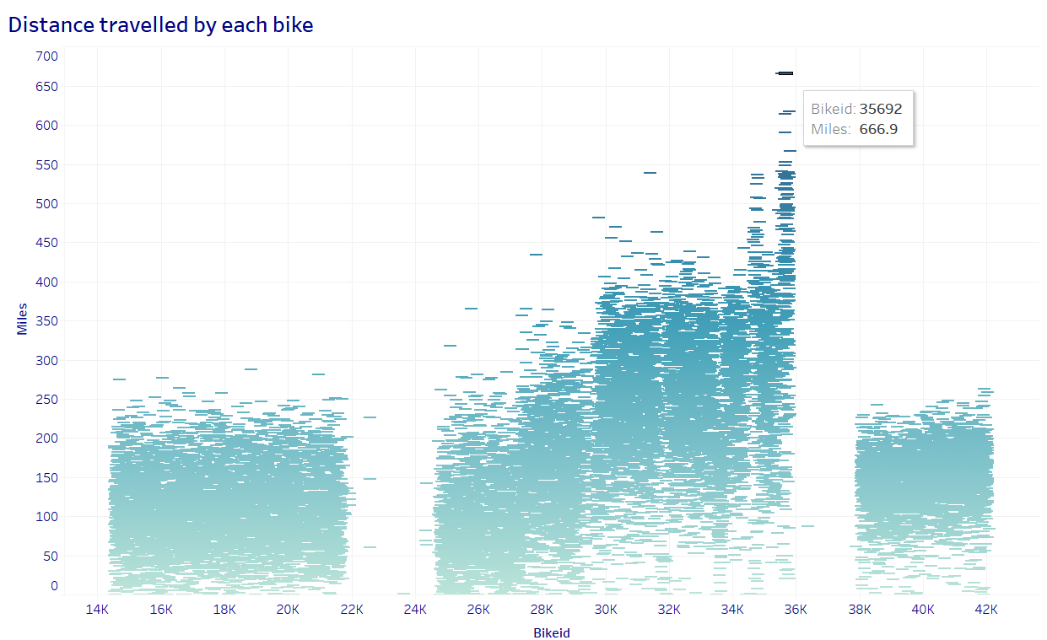
Miles travelled by each bike

Slide 13
Summary
Below questions around the data recorded has been answered.
CitiBikes are popular among which type of riders?
When are the bikes mostly used?
What are the most popular routes?
How many bikes a station has?
Bike statistics – as additional analysis
When the above questions get their answers, the phenomenon speaks for itself!

